Slide 1








LOAN PREDICTION MACHNINE LEARNING
ROHIT MANRAL

Slide 2
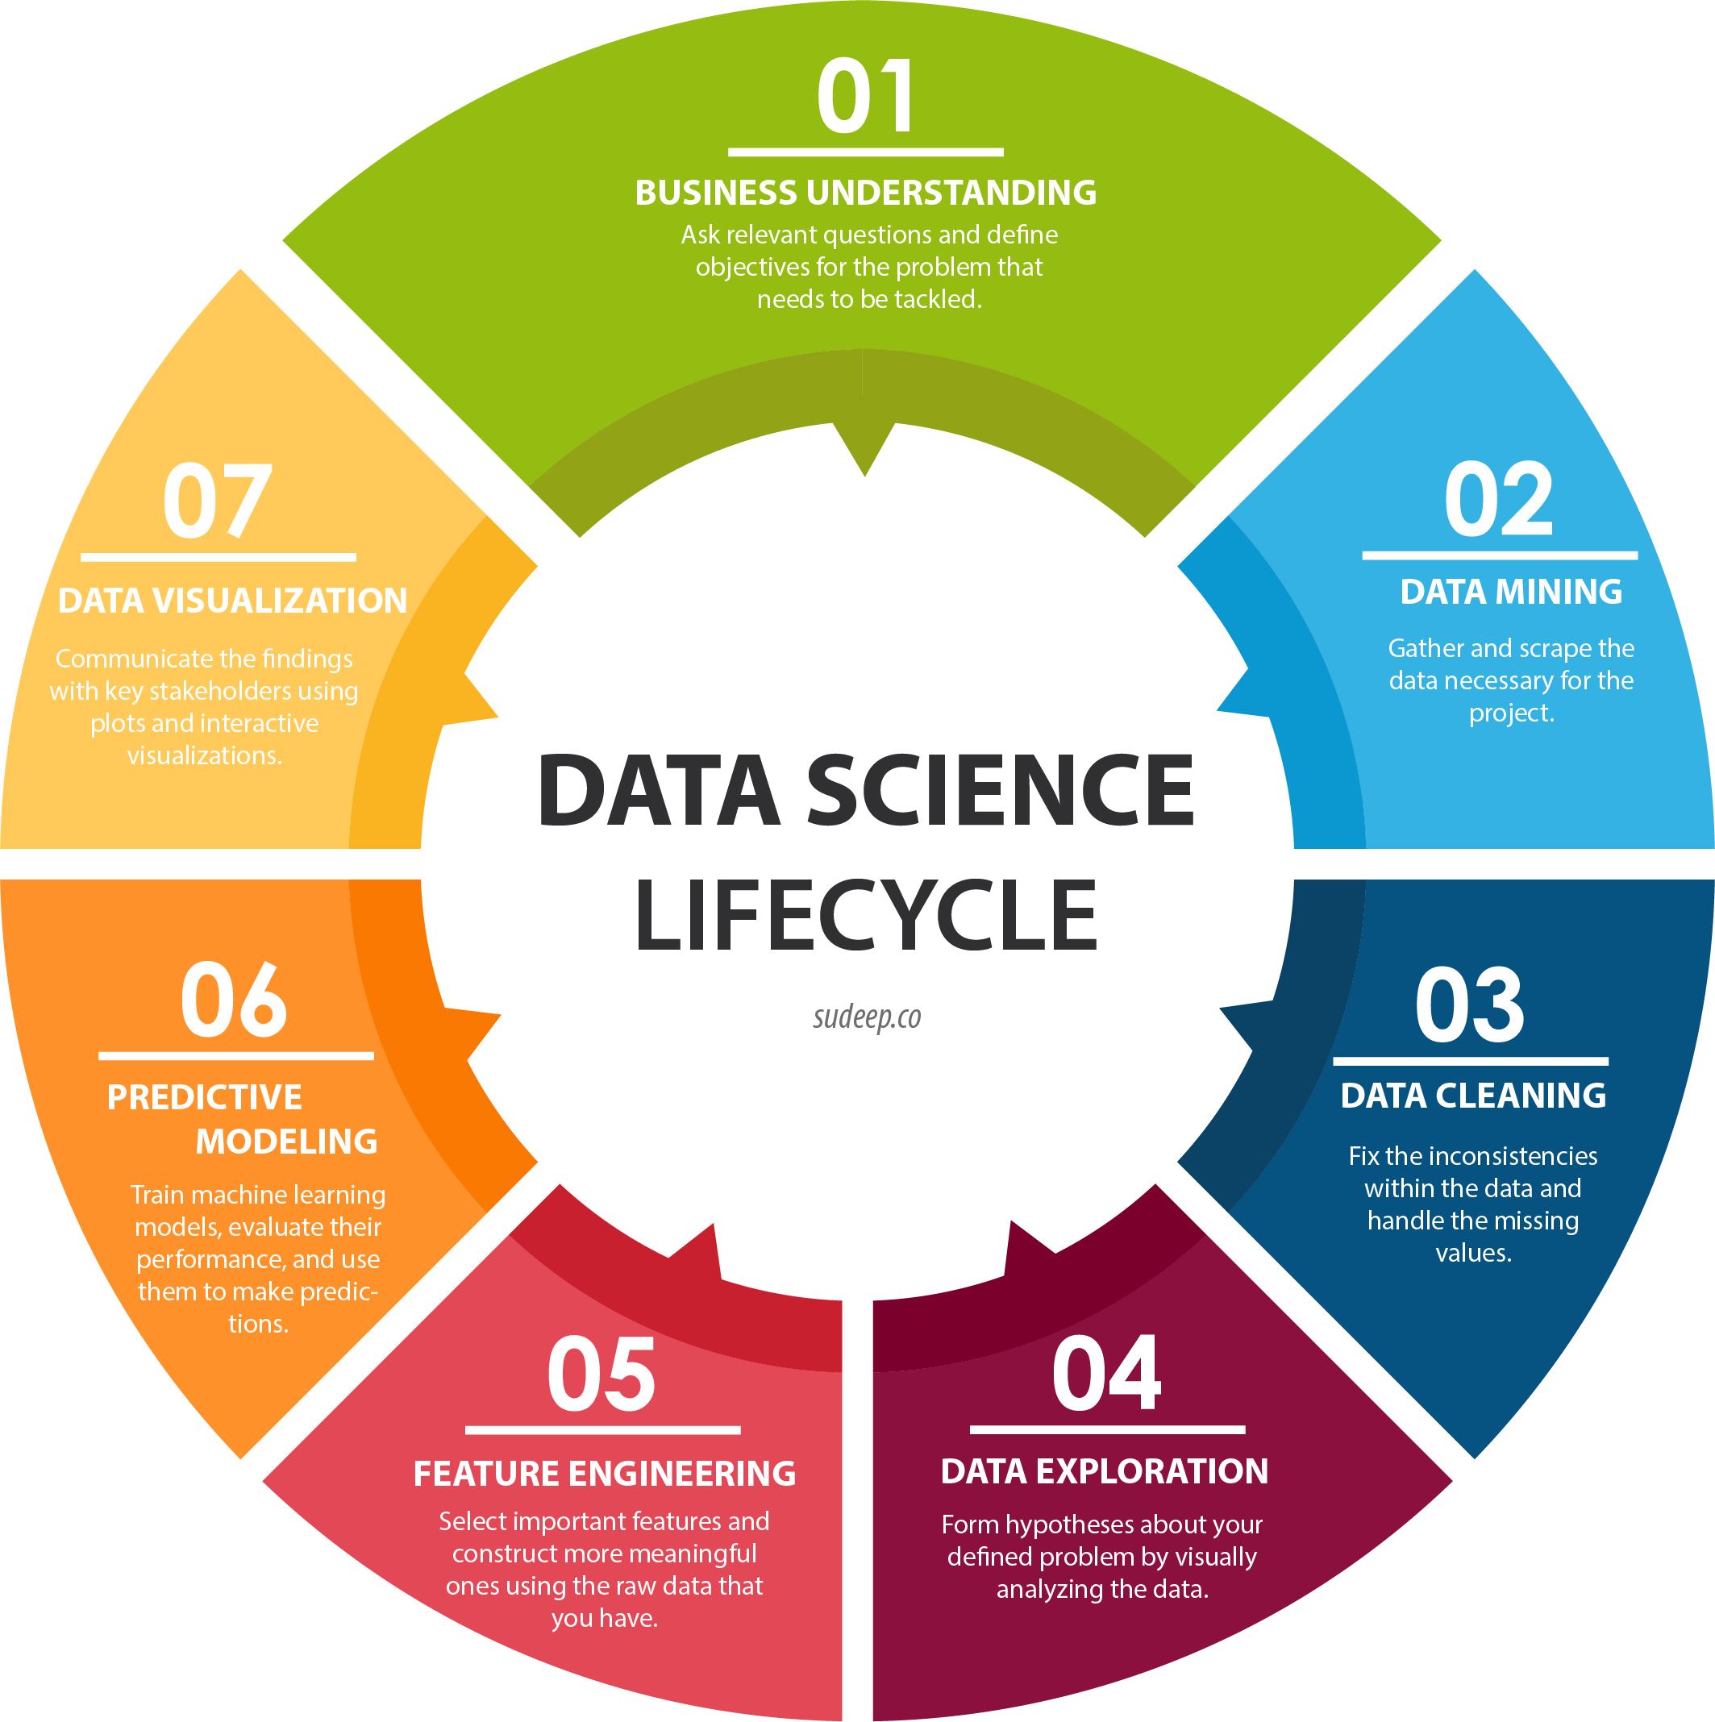
PROJECT CONTENT

Slide 3

01.
BUSINESS UNDERSTANDING
The ultimate goal is to predict the loan approval using Machine Learning based on historic loan approval dataset.

Slide 4

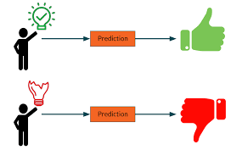
The major aim of this project is to predict which of the applicants will have their loan approved.

Slide 5
02.
DATA MINING
The data source is Kaggle.

Slide 6
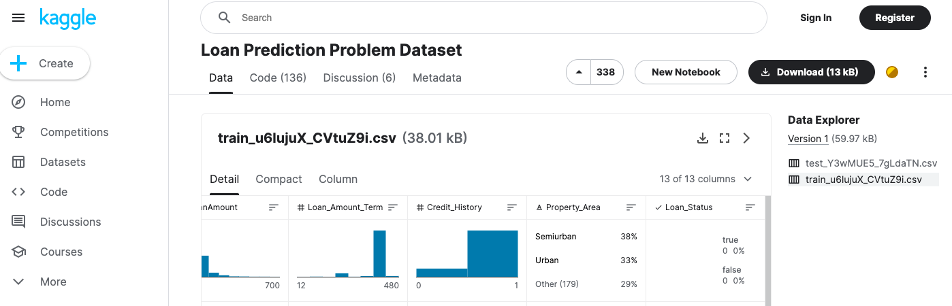
KAGGLE DATASET
2005
2008
2010
01
02
03
Jupiter is the biggest planet of them all
Venus has a beautiful name, but it’s hot
Saturn is a gas giant with several rings
Kaggle Loan dataset containing 614 records under 13 attributes.
Data Source: https://www.kaggle.com/datasets/altruistdelhite04/loan-prediction-problem-dataset?select=train_u6lujuX_CVtuZ9i.csv

Slide 7
03.
DATA CLEANING
To make data consistent and fix missing values.

Slide 8
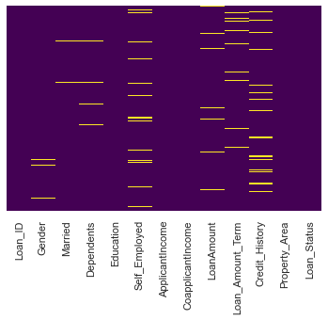
MISSING VALUES CHECK
Above Heatmap shows that Gender, Married, Dependents, Self_Employed, LoanAmount, Loan_Amount_Term, and Credit_History got some null values.

Slide 9
FIXING MISSING VALUES
Below there are 2 steps to deal with missing value attributes: Step 1: Drop features with more than 30% of data missing. Step 2: Fill all the null values of a particular attribute with its mode.

Slide 10
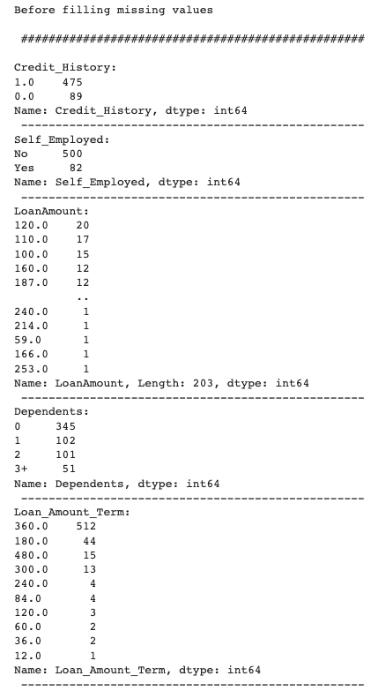
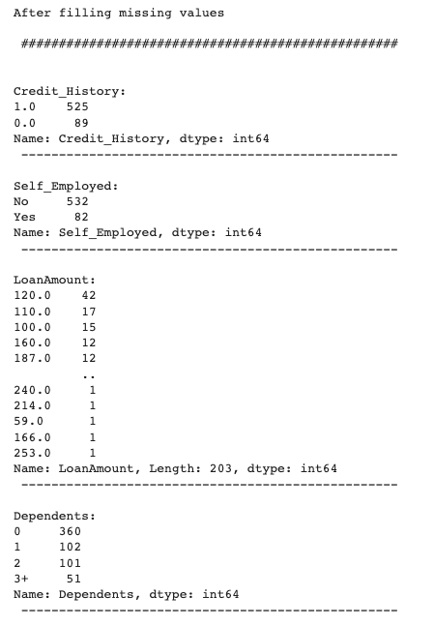
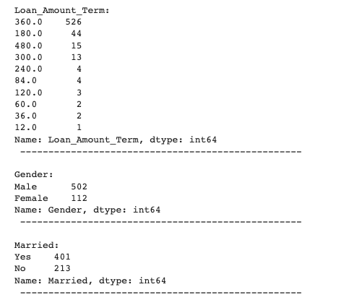
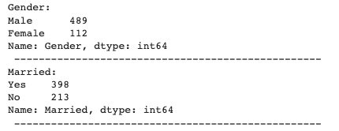
FIXING MISSING VALUES

Slide 11
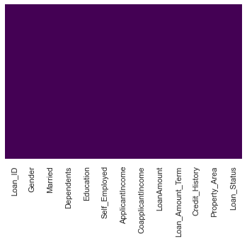
MISSING VALUES CHECK
Above Heatmap shows that no null values present anymore.

Slide 12
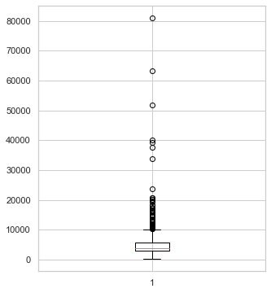
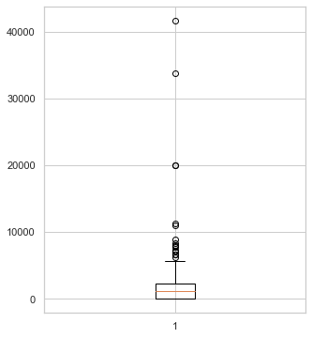
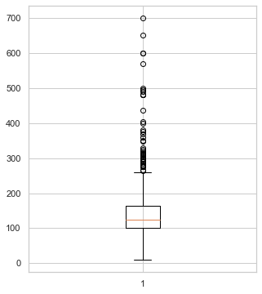
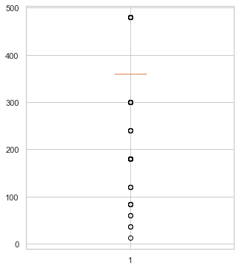
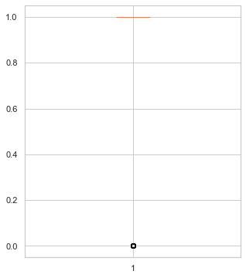
OUTLIERS CHECK
ApplicantIncome
CoapplicantIncome
LoanAmount
Loan_Amount_Term
Credit_History
Though, all the numerical attributes got outliers, we will not actually remove the outliers here because our data already got less records. However, in case of dataset with high number of records we prefer to remove the outliers to make our ML model more accurate.

Slide 13
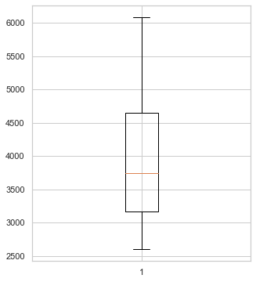
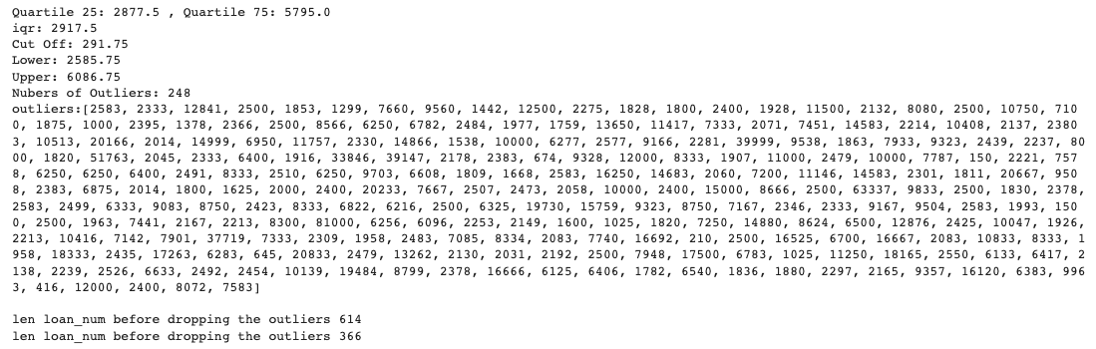
OUTLIERS REMOVAL
ApplicantIncome
As an example, we removed outliers from ApplicantIncome and created the Boxplot to verify no outliers present anymore.

Slide 14
04.
DATA EXPLORATION
Visually analyzing the data and forming relations as per our defined business problem.

Slide 15
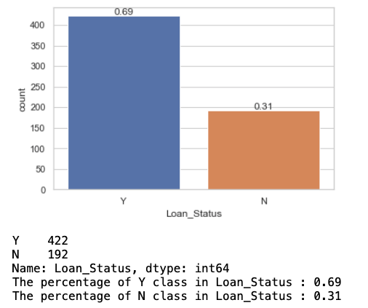
Loan_Status DISTRIBUTION

Slide 16
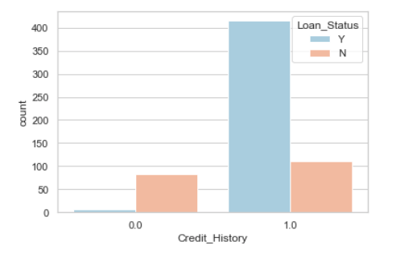
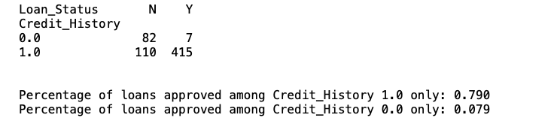
Credit_History Vs Loan_Status DISTRIBUTION

Slide 17
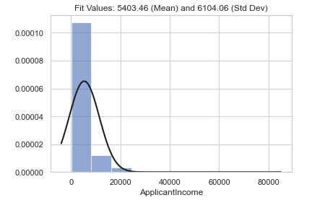
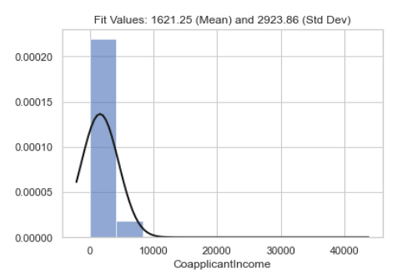
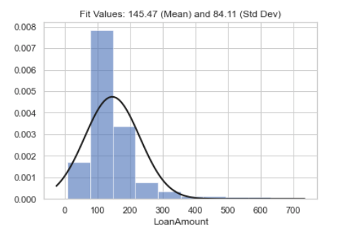
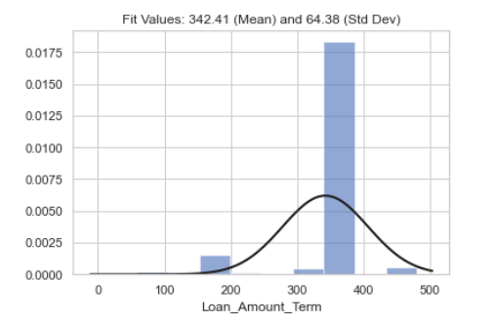
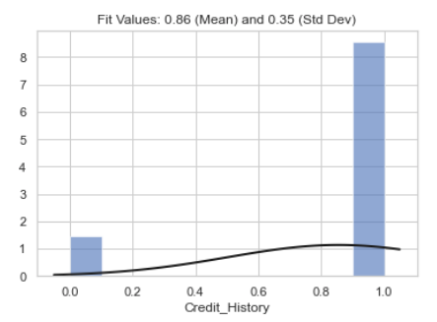
Numeric Attributes’ DISTRIBUTION
* ApplicantIncome & CoapplicantIncome are Right Skewed.
* LoanAmount & Loan_Amount_Term are almost Normally Distributed.
* Credit_History is Bimodal as it got 2 unique values only.
Note: Skewness because of outliers presence.

Slide 18
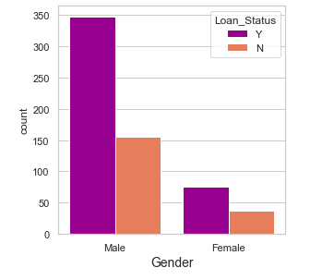
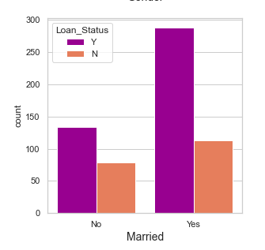
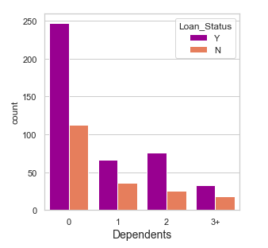
Categorical Attributes’ DISTRIBUTION
* Most males got loan and most females got one too (No specific pattern in Loan_Status vs Gender Bar chart).
* Mostly married applicants got the loan approved, so married applicants got better chance to get a loan approved.
* If loan applicant got no dependents (Dependents = 0), then very hight chance of getting the loan approved. However, as number of dependents increases the chance of loan approval decreases.

Slide 19
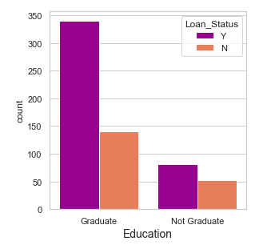
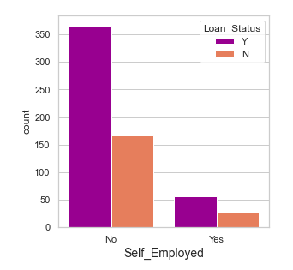
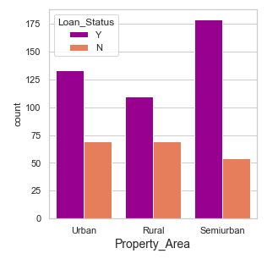
Categorical Attributes’ DISTRIBUTION
* The level of Education (graduated/ not graduated) does not make a significant difference in loan approval, besides majority of loan applicants were Graduated that's why their loan approval count is high, however most of the loan applicants who did not graduate also got loan approved.
* Self Employment also does not make any difference in loan approval same as Education.
* As per Property Area, Semiurban Property_Area got almost 70% chance of loan approval followed by Urban Property_Area which got around 50% chance of loan approval.

Slide 20
05.
FEATURE ENGINEERING
Selecting the important features and eliminating the non-essential ones.

Slide 21
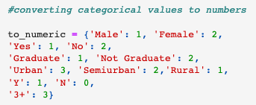
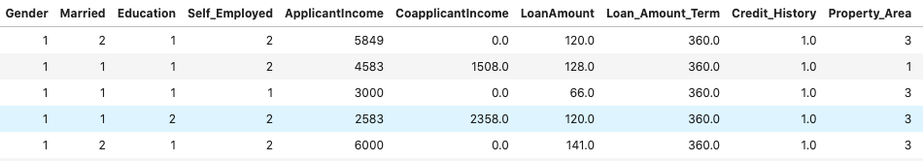
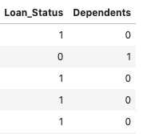
ENCODING DATA TO NUMERIC

Slide 22
FEATURE ENGINEERING
Below there are 2 methods to perform feature engineering:
Method 1: Correlation Matrix
Method 2: Recursive Feature Estimation (RFE)

Slide 23
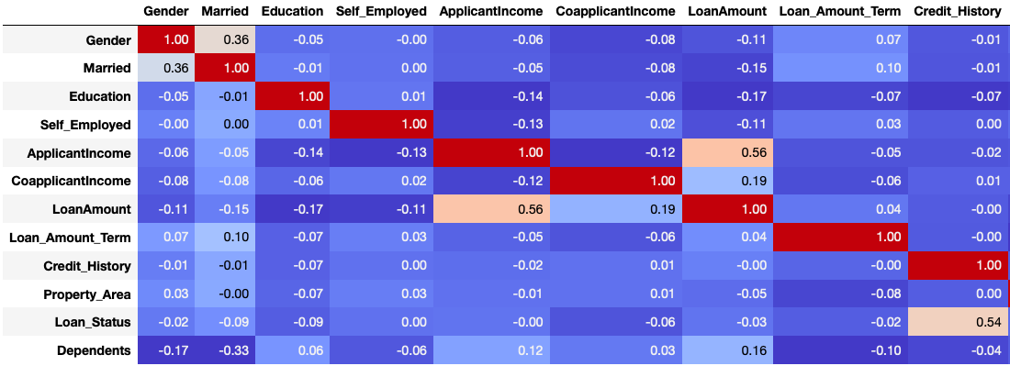
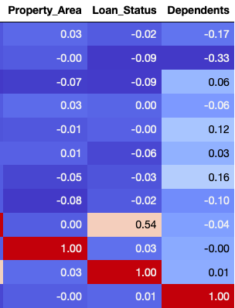
CORRELATION MATRIX
* Credit_History has the highest correlation of 0.54 with Loan_Status. Therefore, our Loan_Status is highly dependent on loan applicant's Credit_History.
* There is a strong correlation between LoanAmount & ApplicantIncome of 0.56
* Also there is a moderate correlation between Married & Gender of 0.36
*However, CoapplicantIncome, ApplicantIncome, Loan_Amount_Term, LoanAmount are least correlated but we are not dropping them as our dataset got less number of records.

Slide 24
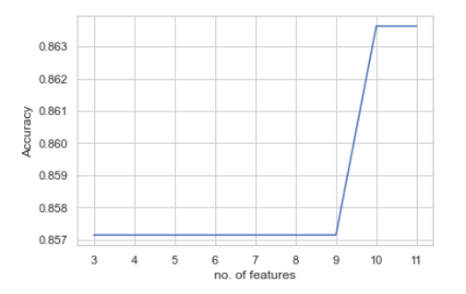
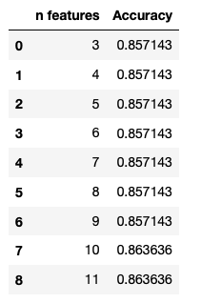
RECURSIVE FEATURE ESTIMATION
* RFE showed that accuracy was higher while selecting almost all the features (n = 10 or 11). Hence, we will not drop any attribute/ column from our dataset.
* Even coordinating with Correlation matrix's results where we did not see any strong reason to drop any attribute.

Slide 25
06.
PREDICTIVE MODELING
Splitting data into train-test set and applying ML algos (supervised & unsupervised ); training & evaluating model’s performance to make optimal predictions.

Slide 26
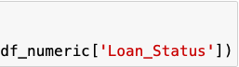
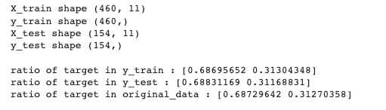
DATA SPLIT (TRAIN-TEST)
First of all, we will divide our dataset into two variables X as the features we defined earlier and y as the Loan_Status the target value we want to predict.
As target values (y) are splitted in proper ratio, so we can start ML modelling now.

Slide 27
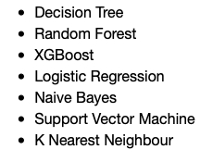
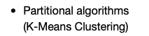
MACHINE LEARNING MODELLING
MACHINE LEARNING
SUPERVISED
UNSUPERVISED

Slide 28
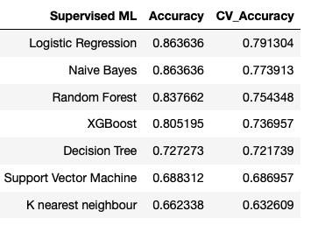
SUPERVISED ML
* The Logistic Regression & Naive Bayes algorithm are the most accurate Supervised

Slide 29
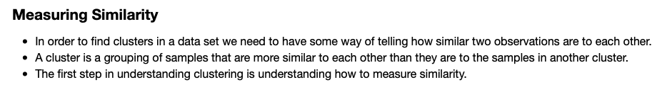
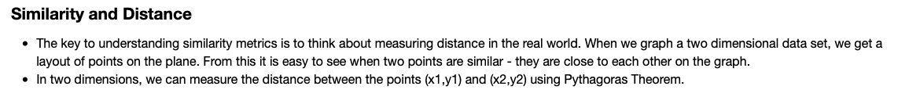
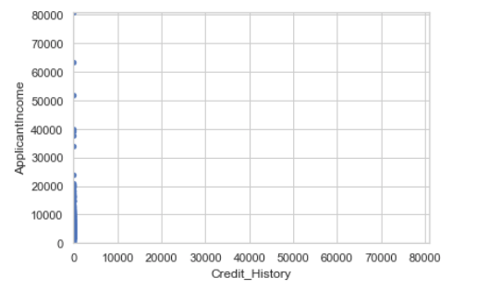
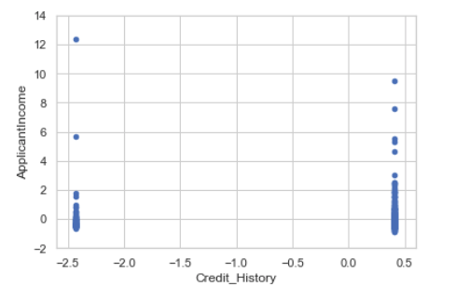


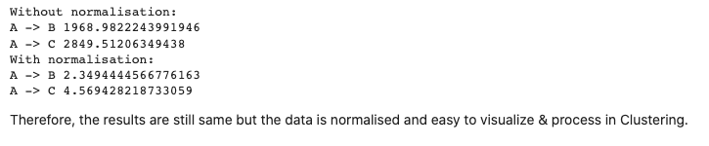
UNSUPERVISED ML

Slide 30
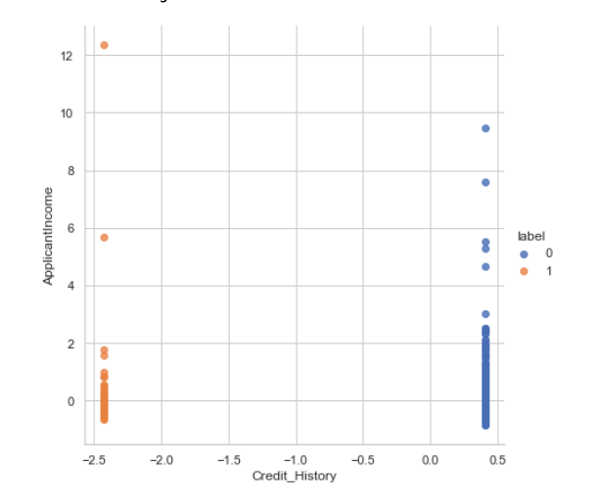
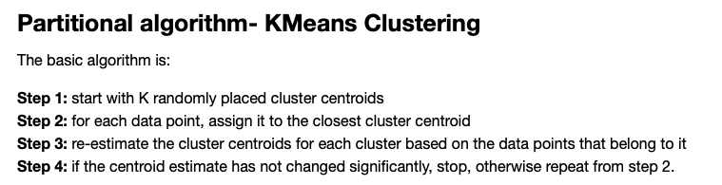
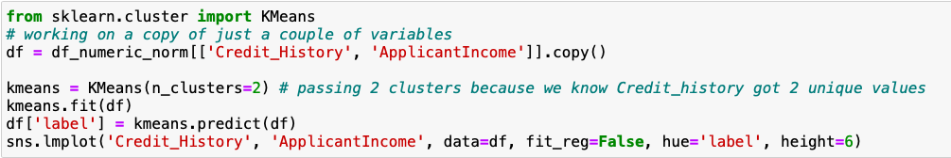
UNSUPERVISED ML

Slide 31



UNSUPERVISED ML

Slide 32
07.
DATA VISUALIZATION
Communicating the findings based on charts and other visualizations.

Slide 33

SUPERVISED ML
* Credit_History is a crucial variable because of its high correlation with Loan_Status.
* The Logistic Regression & Naive Bayes algorithm are the most accurate Supervised
* ML algorithms here: approximately 86%, besides Logistic Regression is more preferable as per Cross Validation scores.

Slide 34


UNSUPERVISED ML

Slide 35
THANKS
Do you have any questions?
rohit.manral@students.mq.edu.au
0434038738

